Slide 1
Emission Analyzer
Presented By
Brie Haynes, Josh Pahman, Gregory Rodriguez, Srinesh Ganesh, Yousuf AlMakhamreh, Victor Sim

Slide 2
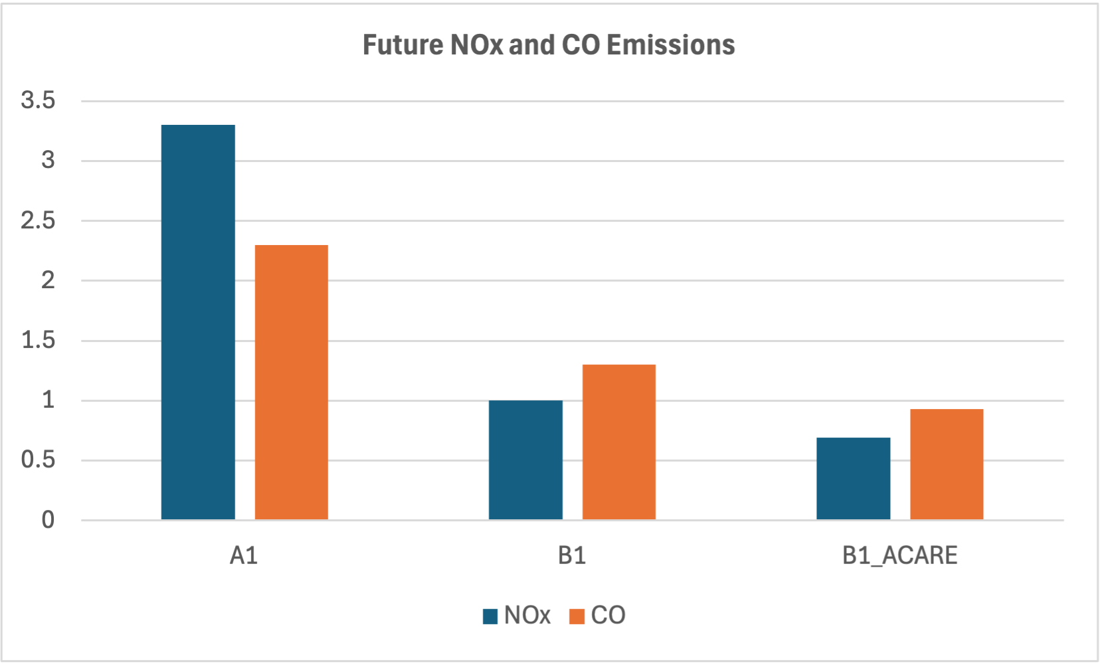
The Problem
Aviation, particularly commercial jet engines, is a significant contributor to air pollution and climate change.
CO and NOx emissions are interdependent—reducing one often leads to an increase in the other
How do we handle co-regulation?

Slide 3
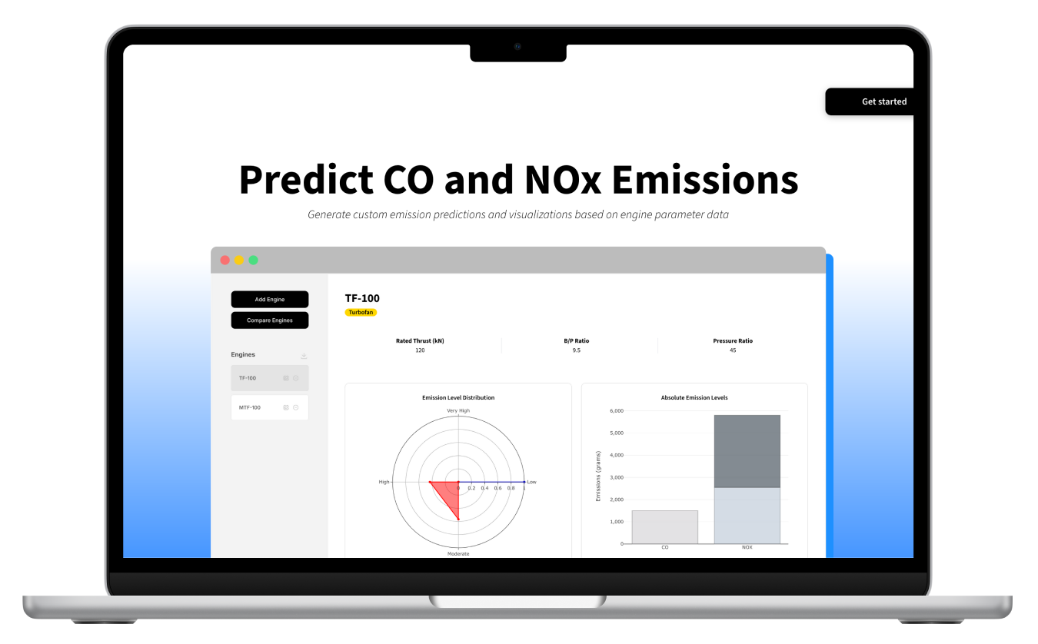
Our Solution
A web application that predicts the CO and NOx emissions of commercial jet engines using three key operational parameters
Rated thrust
B/P ratio
Pressure ratio
Provide intuitive visualizations of emission predictions to support user analysis and decision-making

Slide 4
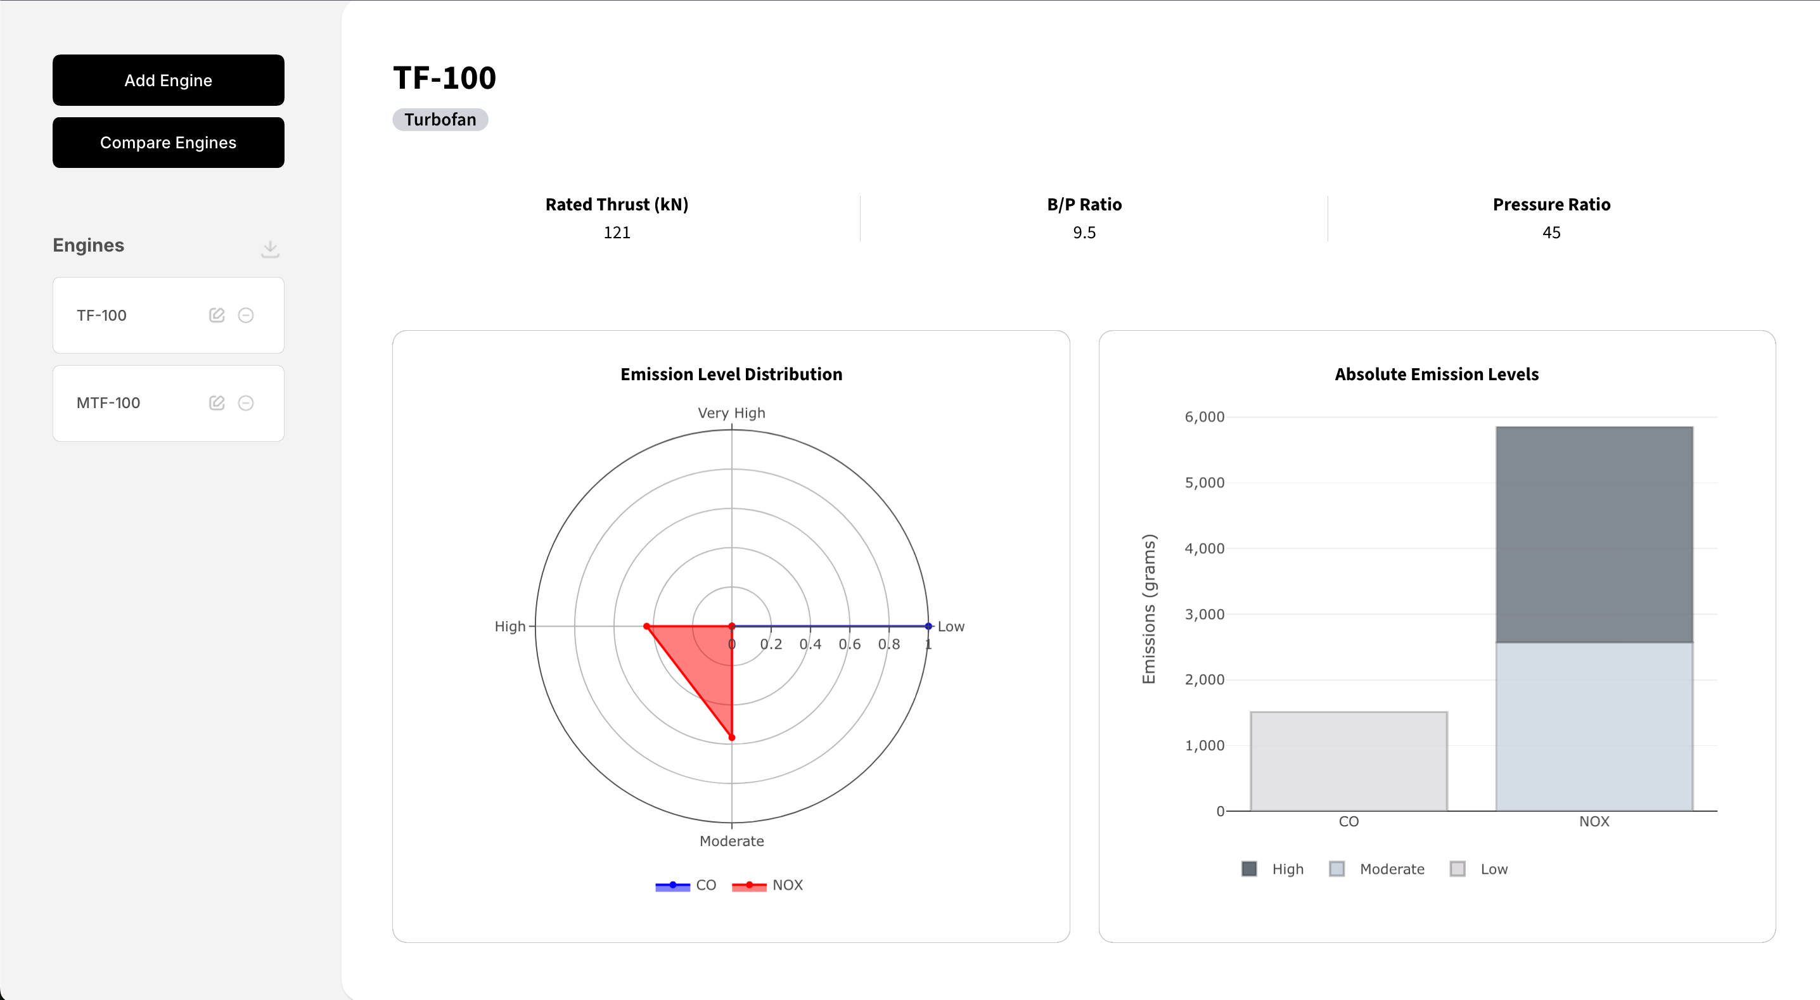
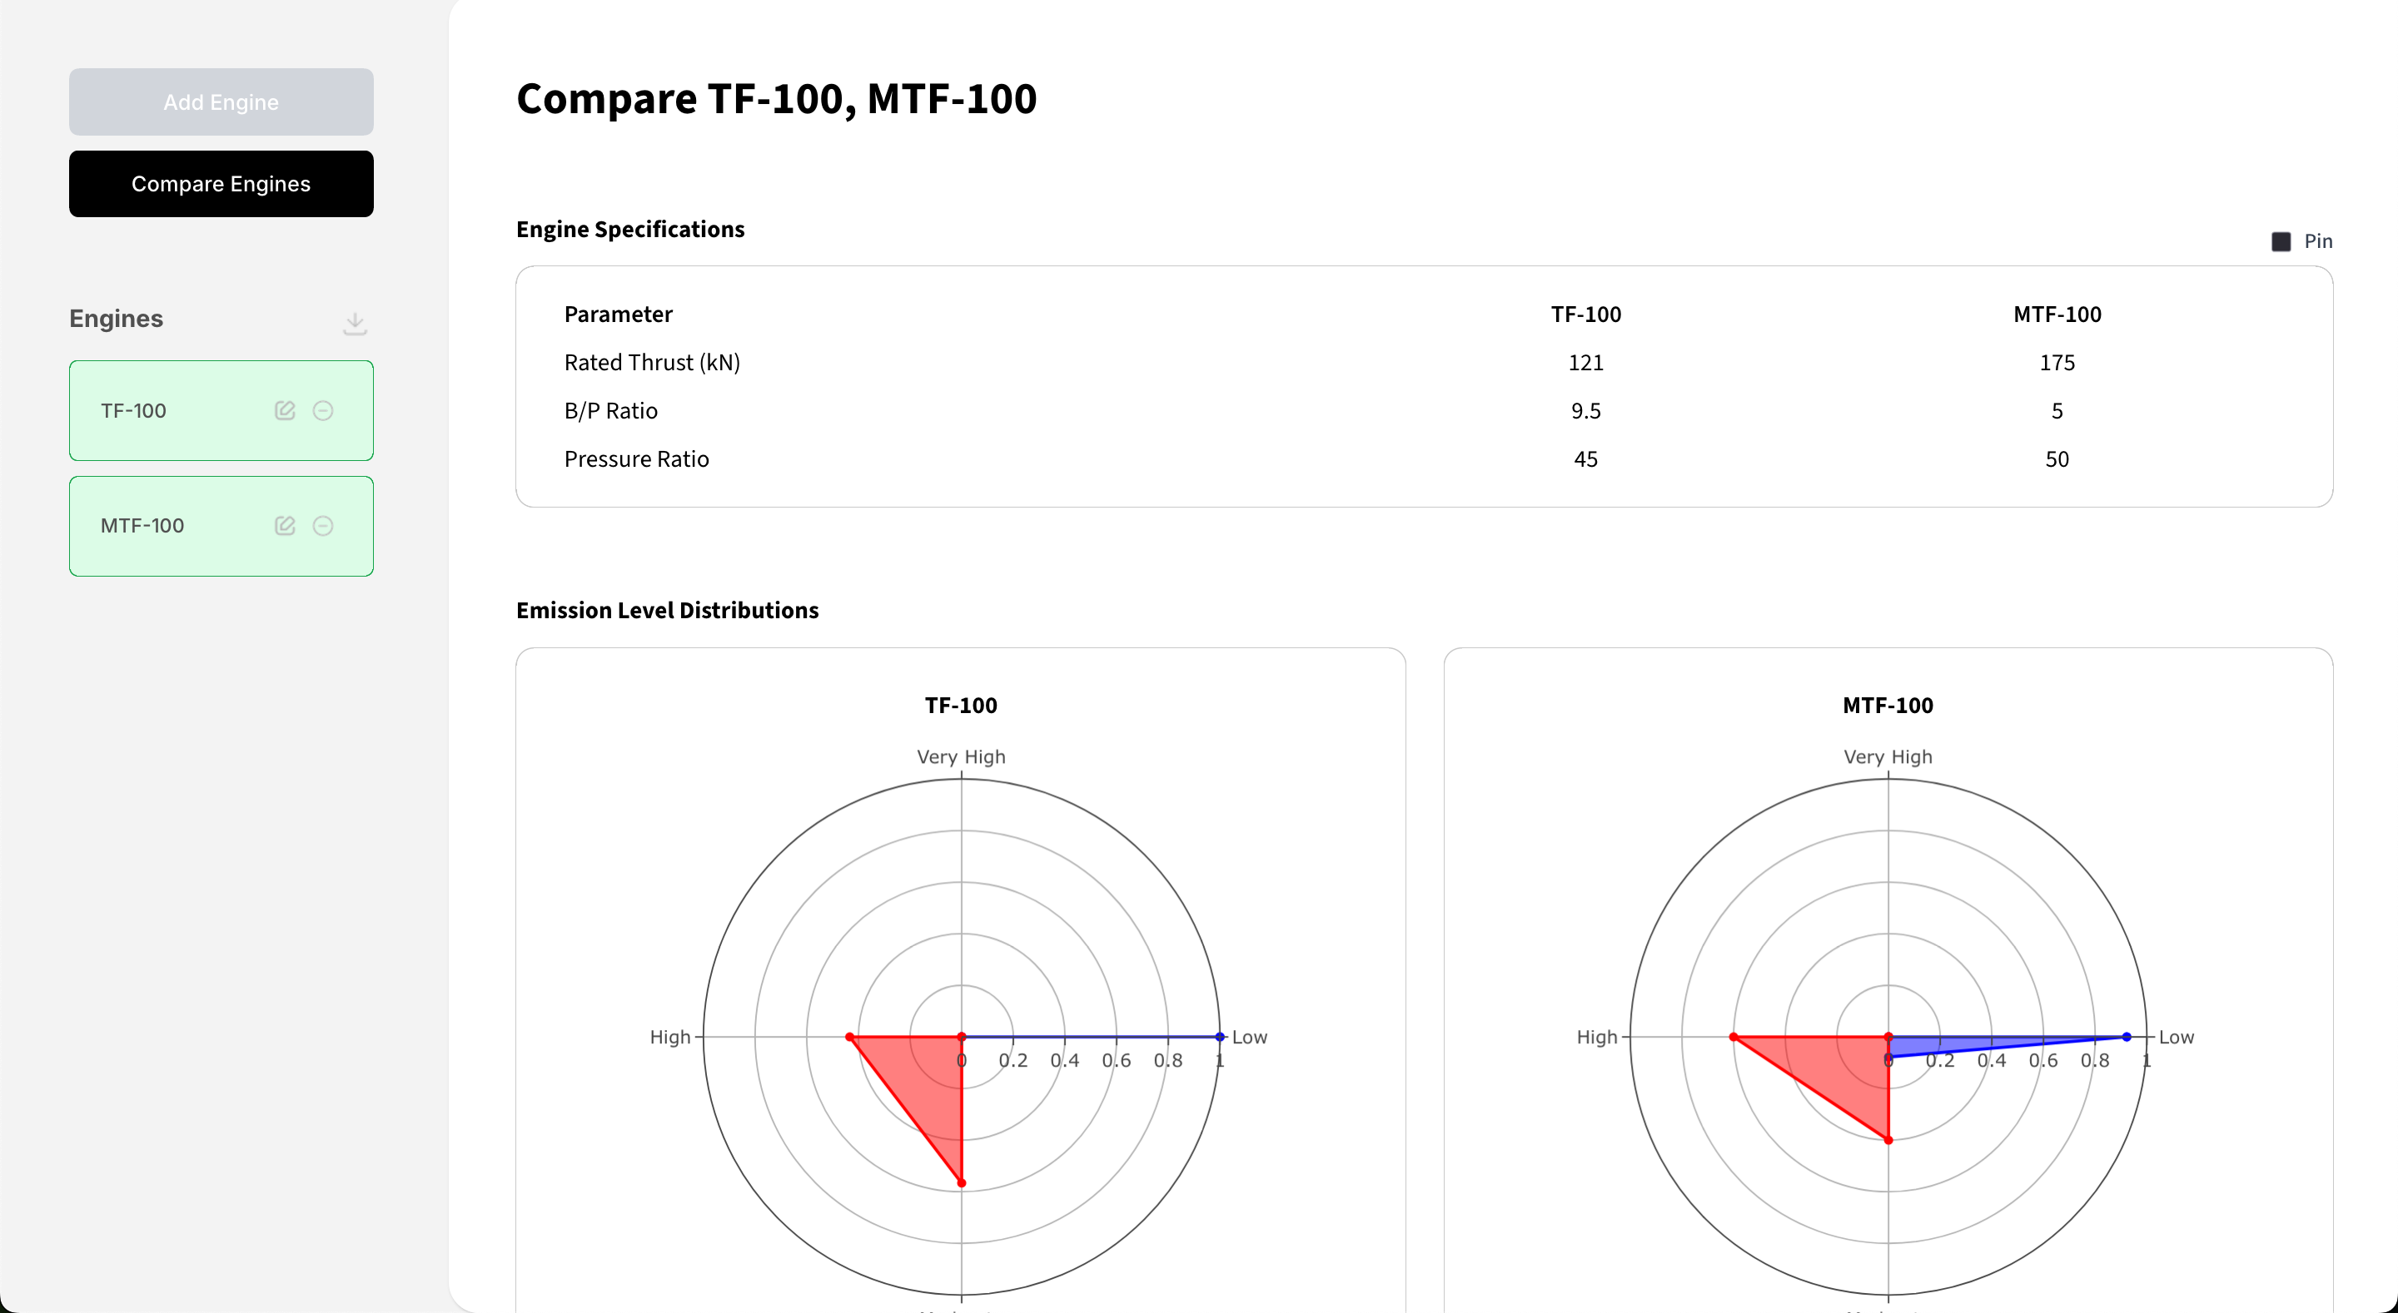
Key Features
Users can:
Manage the engines associated with their account by adding, editing, and deleting them
Download the prediction data for all engines
View data visualizations of the emission predictions
Compare the CO and NOx emissions of multiple engines

Slide 5
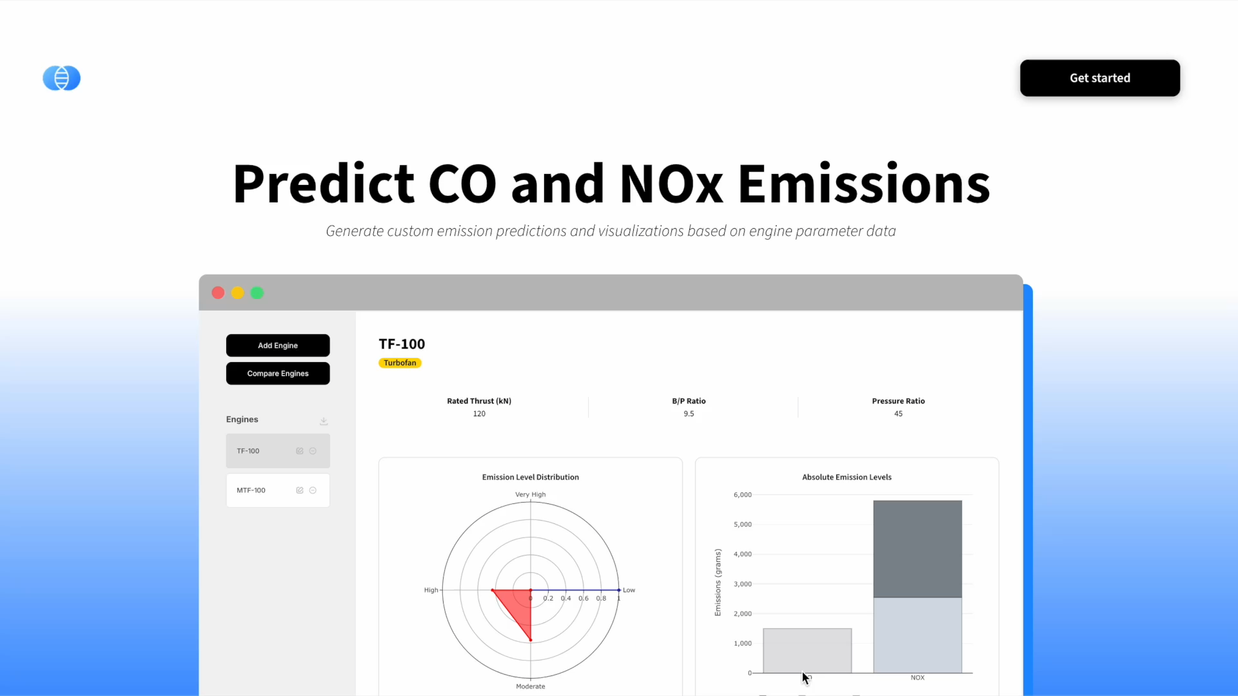

Slide 6

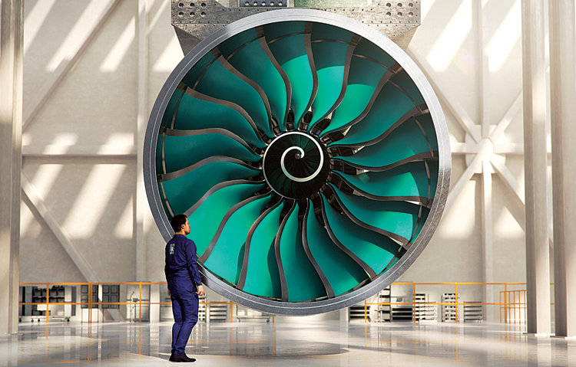

Stakeholders
Aerospace researchers
Quickly visualize emission profiles
Propose innovation to reduce pollutants
Engine manufacturers and engineers
Must design engines that meet environmental regulations
Can use the app to compare engines
Environmental analysts
Evaluate broader environmental impact of engine emissions
Support data-driven reporting

Slide 7
Architecture & Tech Stack

Slide 8
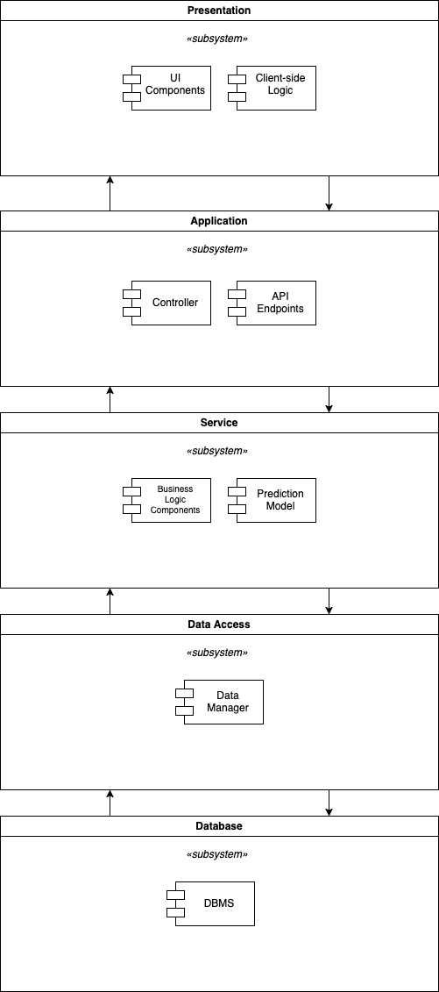
Architecture
5-tier layered architecture
Presentation
Application
Service
Data Access
Database

Slide 9


Frontend
Frameworks and Libraries
React + Vite: Built dynamic front-end interfaces using reusable components, props, and state management.
Tailwind CSS: Streamlined styling through utility-first, in-line classes for responsive design.
Axios: Handled HTTP requests and integrated APIs for data fetching and submission.
Plotly.js: Developed interactive Radar and Stacked Bar Charts for visualizing analyzed data.
Primary Features
Provides a user-friendly interface for users to manage their engines and visualize prediction data

Slide 10


Backend
Frameworks and Tools
Django: Developed API endpoints to allow users to perform various actions
Postman: Verified that endpoints worked as expected through testing with various request payloads
PostgreSQL: Stored results from various user actions and endpoint tests into corresponding tables in the database
Docker: Containerized the server, database, and prediction model for portability
Primary Features
Data persistence
API endpoints that allow users to
Add, edit, and remove engines
Predict CO and NOx emissions

Slide 11
Prediction Model
Dataset:
ICAO Aircraft Engine Emissions Databank from the EASA (EU Aviation Safety Agency)
Tools:
MATLAB R2023A
Methodology:
Imported ICAO dataset into MATLAB
Cleaned/repaired data using MATLAB's analysis tools (e.g., removing outliers, filling gaps with approximations)
Used PCA (Principal Component Analysis) to reduce data dimensionality and select feature subset
Used MATLAB's Classification Learner toolset to train both CO and NOx emission models using 3 primary features
Selected bagged tree ensemble approach for highest predictive power and highest validation/test set accuracy
Used MATLAB Coder to generate hardware-optimized C code for both models
Customized and cleaned generated code to add interactivity with web backend

Slide 12
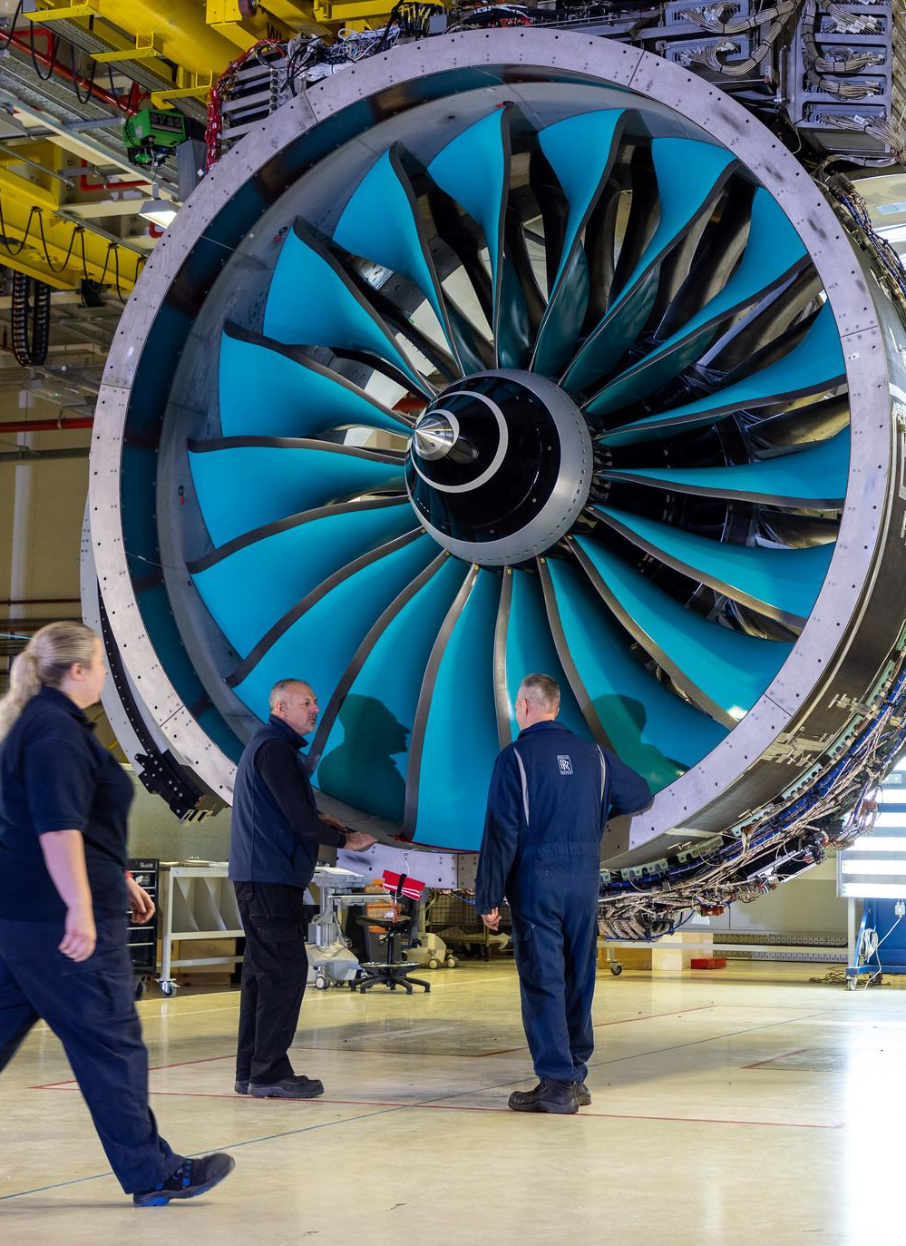
Conclusion
The Emission Analyzer provides a powerful tool for predicting/visualizing the co-regulation of CO and NOx emissions (Jet Engines)
Key achievements:
User-friendly interface & Interactive visualizations for single-engine analysis and multi-engine comparison
Accurate prediction model using bagged tree ensemble approach
Comprehensive 5-tier architecture (Robustly Test)
Mistakes:
Feature Handling / Hyperparameter tuning could have been done better for better accuracy/precision
Handling Scope and Finer Design Details was a challenge
Empowers Industry (aerospace researchers, engine manufacturers, and environmental analysts) to make data-driven decisions
Future work could include expanding the model to predict additional pollutants, incorporating more operational parameters (Frontend/Backend), more visuals.

Slide 13
References
https://www.easa.europa.eu/en/domains/environment/icao-aircraft-engine-emissions-databank
https://www.icao.int/environmental-protection/pages/aircraft-engine-emissions.aspx
https://acp.copernicus.org/articles/22/11987/2022/acp-22-11987-2022.pdf

Slide 14
Any Questions?

